Slide 1


In-Situ Butanol Recovery from Fermentations via Expanded-Bed Adsorption
April 21, 2012
Michael Wiehn
Dr. David Nielsen
2012 NASA Space Grant Symposium
University of Arizona

Slide 2

Motivation
Global crude oil depleted in 40 years
Replace gasoline with bio-butanol
n-Butanol can be burned in automobile engines
Enthalpy of Combustion:
  Gasoline – 44.40 MJ/kg
  n-Butanol – 33.08 MJ/kg

Slide 3
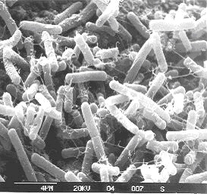
Biobutanol
Clostridium acetobutylicum
  Rod-like shape, anaerobic,
  soil bacteria
  Glucose fermentation into butanol, acetone, and ethanol – 6:3:1 ratio
  Wild-type butanol production rate of
  0.37 g/L·hr
Butanol is lethal above 10 g/L

Slide 4
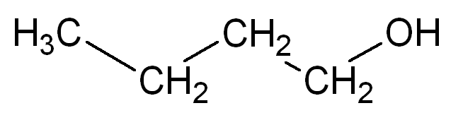
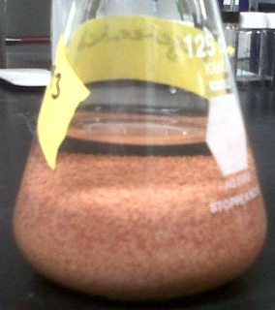
Adsorption
Hydrophobic polymer resins
  0.30-0.84 mm in size
  Over 1,100 m² surface area per gram
Butanol
  Hydrophobic carbon chain
  Hydrophilic alcohol group

Slide 5
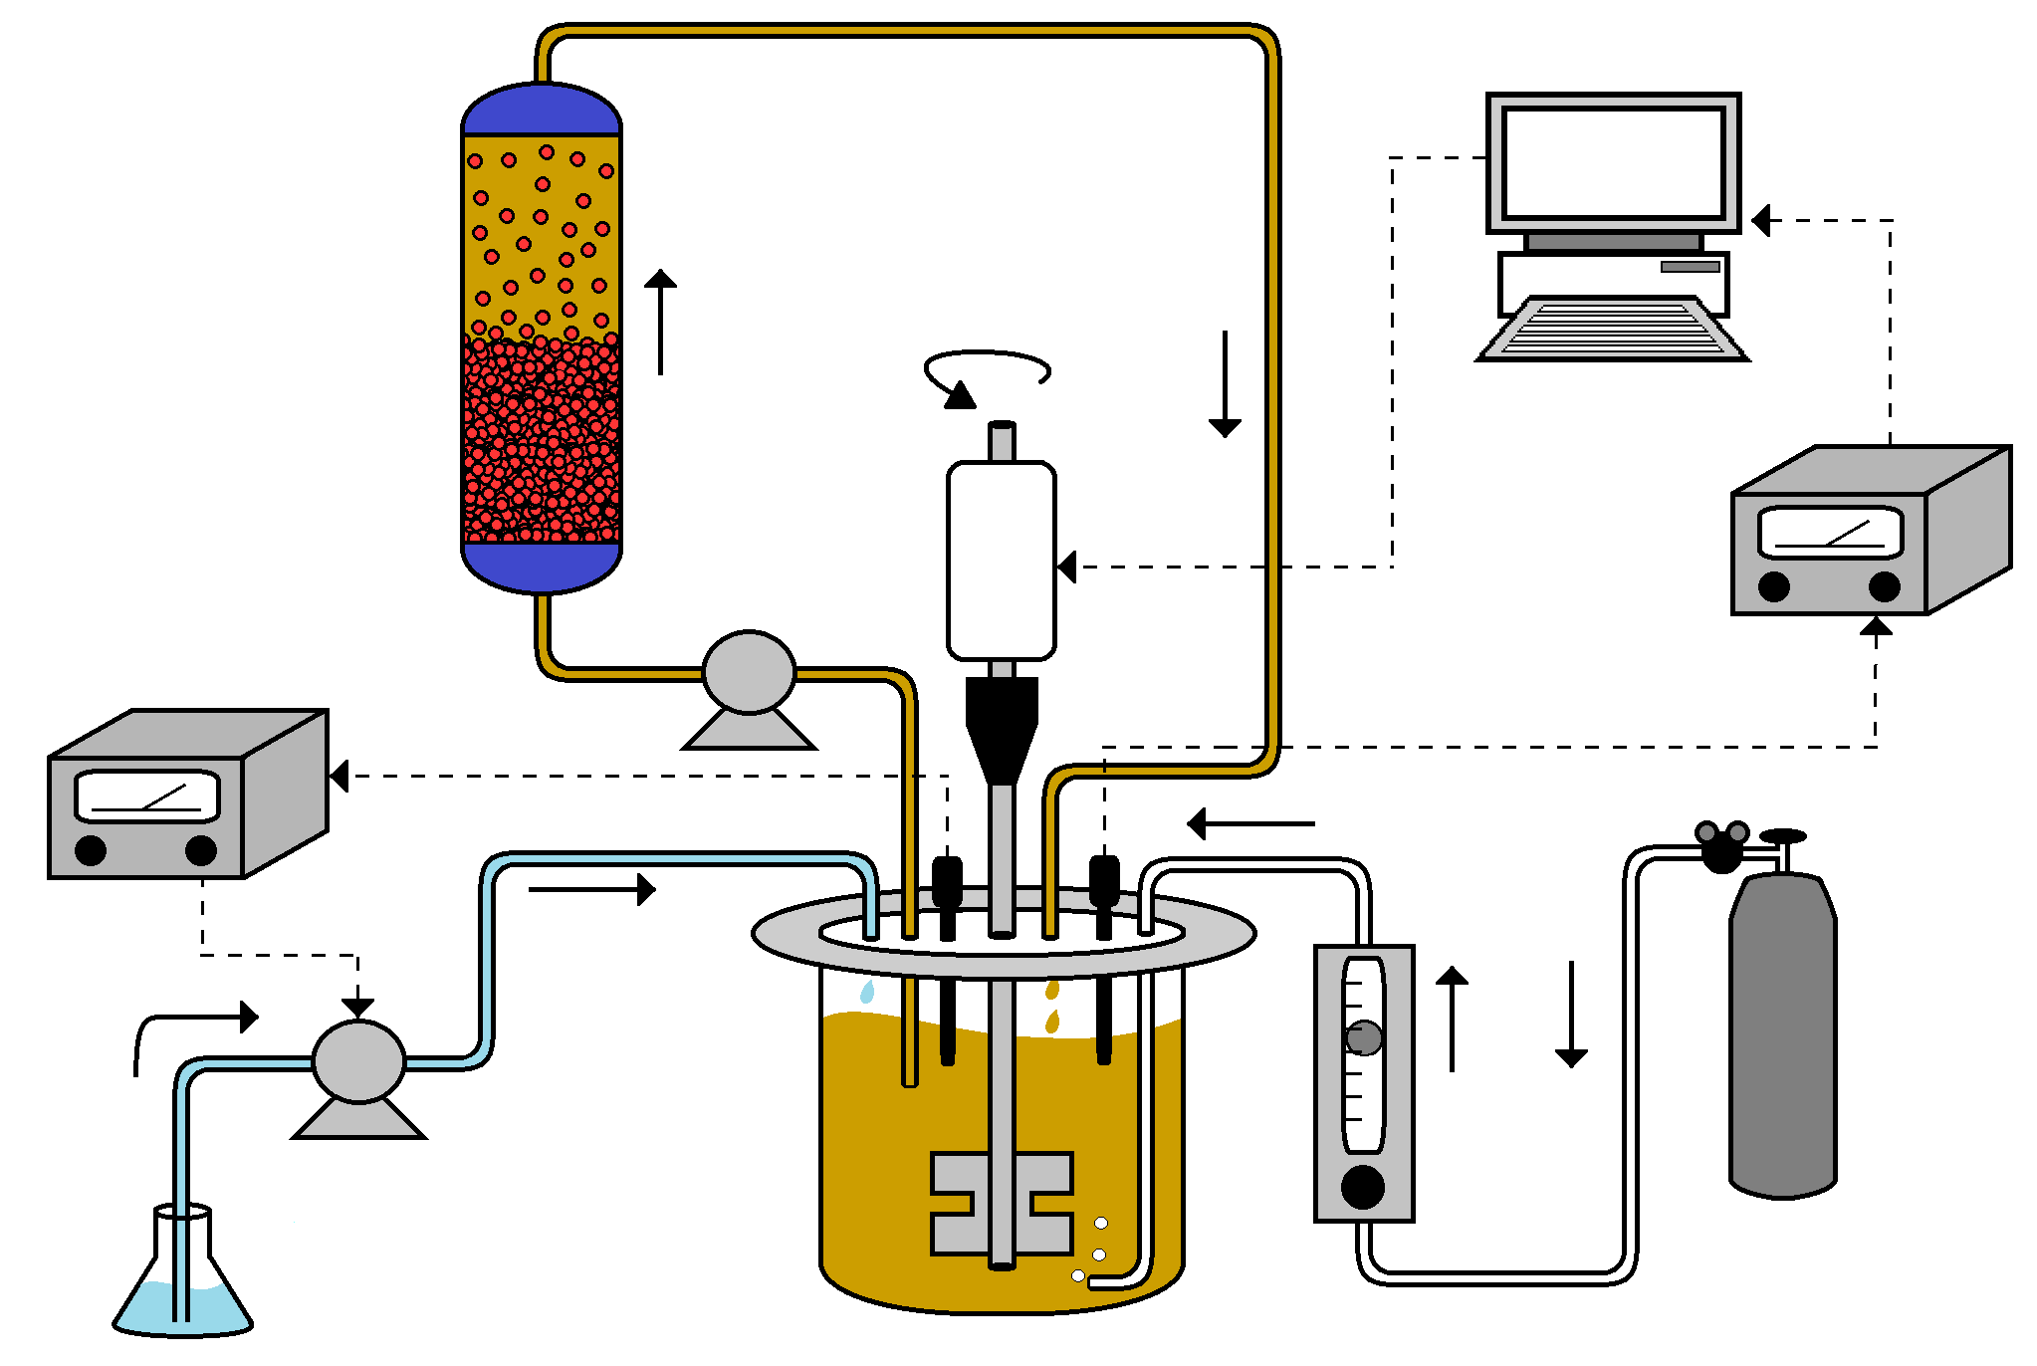
Process Flow Diagram

Slide 6
Results
40 g wet resin
80 g wet resin
120 g wet resin

Slide 7
Conclusions
Butanol is a viable option for gasoline replacement as a liquid transportation fuel
Expanded-bed adsorption system can avoid the toxicity ceiling in fermentations
Adsorbents are the most promising method of separation
Future work will entail active bacteria cultures

Slide 8
Thank you!
Questions?

